Slide 1
Village of Cape Vincent Police Outreach
March 9, 2021 – 6:00 P.M.

Slide 2
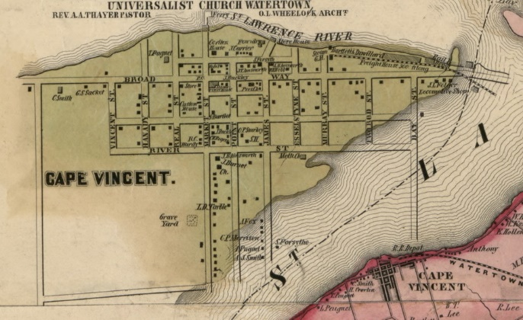
Welcome and Introductions
Mayor Jerry Golden and Officer-In-Charge Shaun Cuddeback

Slide 3
Welcome and Introductions
Mayor Jerry Golden
Officer-In-Charge Shaun Cuddeback
Village Board of Trustees
District Attorney’s Office
Probation/Parole
Public Defender’s Office
Community Stakeholders
- Businesses, secular groups, community groups, etc.

Slide 4
Meeting Topics
Village Police Department Overview
Community-wide Survey Results
New York State Police Reform and Reinvention Collaborative
Next Steps

Slide 5
Village Police Department Overview
Officer-In-Charge Shaun Cuddeback

Slide 6
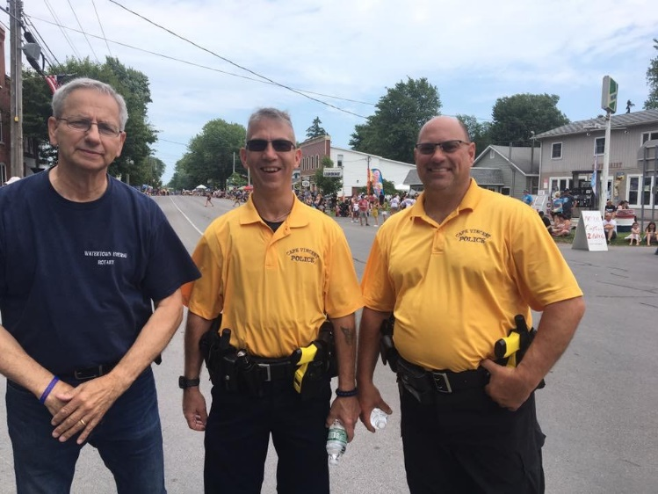
Mission of the Department
The principal goal of the Cape Vincent Police Department is to preserve the rights of the citizens of the Village of Cape Vincent. Our officers strive to reduce fear in the community through the prevention of crime, protection of persons and property, and the maintenance of order in public places. Experienced officers anticipate and respond to events that threaten public order and the protection of life and property.

Slide 7
Mission of the Department
Being a part of Jefferson County creates some unique situations for our village, including sharing a border with Canada and the proximity of Ft. Drum. The Police Department will occasionally work in conjunction with other law enforcement agencies, to include JCSO, NYSP, USBP, USCBP, US Army and the USCG.
This department will at all times work in cooperation with community agencies and groups to promote a common understanding of our efforts in law enforcement.

Slide 8
Department Personnel
Consists of 5 part-time sworn police officers
Currently employ officers from JCSO, WPD and retired NYSP
Officer-In-Charge Shaun Cuddeback manages and supervises the operations of the Department, 14 years with the Village, 2 years as Officer-In-Charge
21 years with the Jefferson County Sheriff’s Office, 3 years as 911 Dispatcher, 9 years as K9 Handler, 8 years as Sergeant, last 4 as Administrative Sergeant
Over 70 years combined law enforcement experience

Slide 9
Department Services
Dedicated Road Patrol and Police Enforcement of the Village
Enforce NYS Penal Law, VTL, and local ordinances
Accident and Criminal Investigations
First Aid Response
Welfare Checks
Home Checks

Slide 10
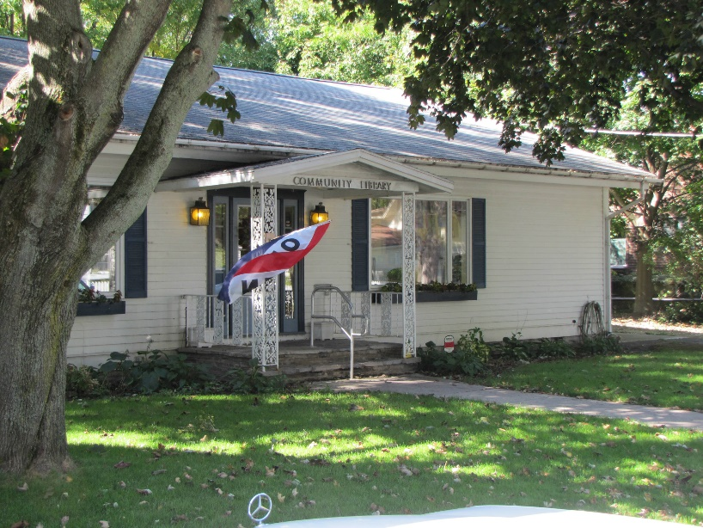
Community Survey

Slide 11
Community Survey Overview
Survey was available to the public from October 21, 2020 – January 1, 2021
Survey distributed by the U.S. Department of Justice, Office of Community Oriented Policing Services (COPS Office) as referenced in the New York State Police Reform and Reinvention Collaborative Resource & Guide for Public Officials and Citizens.

Slide 12
Community Survey Overview
Survey was open to the public
A total of 7 surveys were completed and returned
The survey contained 31 multiple choice questions
Results are included in the Police Reform Report
Thank you to everyone who participated in the survey

Slide 13
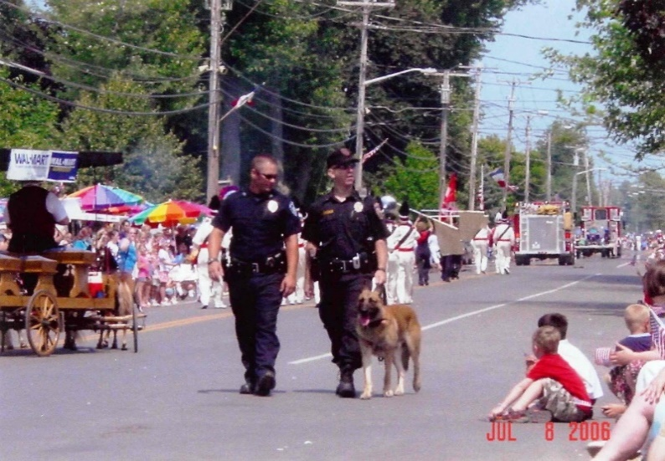
NYS Police Reform and Reinvention Collaborative

Slide 14
New York State Police Reform and Reinvention Collaborative
NYS Governor Cuomo Executive Order 203 requires each law enforcement agency in NYS to create a police reform and reinvention plan in a collaborative manner with the community.
The Village decided on three outreach efforts:
1) Community-wide survey
2) A virtual meeting
3) Soliciting comments on a draft plan.

Slide 15
New York State Police Reform and Reinvention Collaborative
Covers topics that include:
Policy and Procedure
Use of Force
Crowd Management
Community Policing
Community Outreach Efforts
Implicit Bias Awareness Training

Slide 16
New York State Police Reform and Reinvention Collaborative
De-Escalation Training
Restorative Justice Practices
Transparent Citizen Complaint Procedures
Specific Issues Unique to Our Area
Problem Oriented Policing
Focused Deterrence
Attention to Environmental Design

Slide 17
New York State Police Reform and Reinvention Collaborative
Departmental Training
Community and Public Input
Mental Health and Hygiene
Citizen and Internal Complaints

Slide 18
Next Steps
Reform report and PowerPoint presentation will be posted on the Village website at www.villageofcapevincent.org/policies by March 12, 2021.
Community Stakeholders and members of the public are encouraged to review the reform report. The Cape Vincent Police Department welcomes suggestions for ways that the agency can improve the efficient and professional use of resources, increasing the health, safety and welfare of the citizens and visitors to our village.
Comments and suggestions can be left at the Village Office, or emailed to the department at:
capevincentpolice@centralny.twcbc.com

Slide 19
Next Steps
On March 23, 2021 the Cape Vincent Police Department will present a final draft of the reform report to the Board of Trustees, based upon the suggestions from the community and stakeholders.
Once the final reform report is accepted by the Board of Trustees, it will be sent to Albany to be filed in accordance with Governor Cuomo’s Executive Order 203. This is required to be completed by April 1, 2021.
The Police Department will continue to engage the community on a regular basis to maintain the trust and support of our residents and visitors.

Slide 20
Contact Information
ADDRESS
Village Police Office – 177 North James Street, PO Box 337
Cape Vincent, NY 13618
PHONE NUMBERS
(315) 654-3400 Village Police Office Phone for non-emergencies
For emergencies dial 911
ON THE WEB
Village Website: www.villageofcapevincent.org
Police Dept email: capevincentpolice@centralny.twcbc.com

Slide 21
Thank you for your time!

